Slide 1
Engaging Members in FRC Programming
7419 T.E.C.H. Support
William Chen, Kaival Shah, Stephen Xie
The Quarry Lane School, Dublin, CA

Slide 2
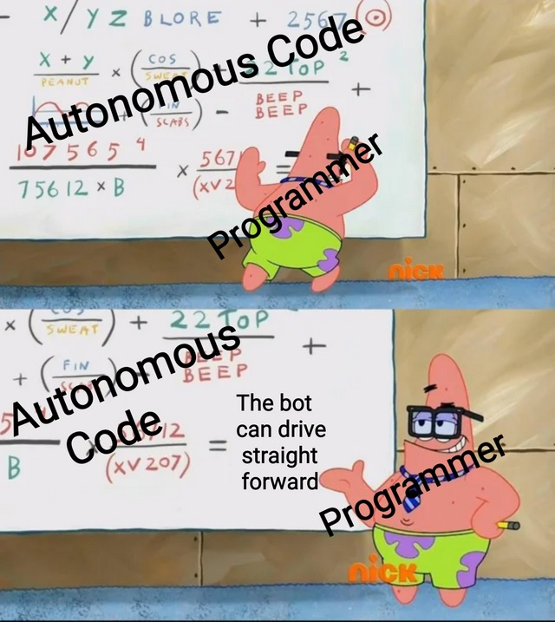
Agenda
Introduction
Student-Led Engagement
GitHub Classroom
Offseason Training Assignments
Interactive Team Activities
Build Season Opportunities
Questions

Slide 3
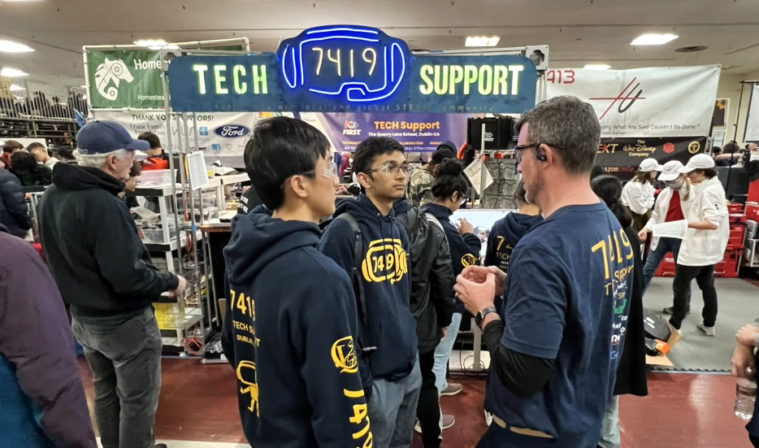
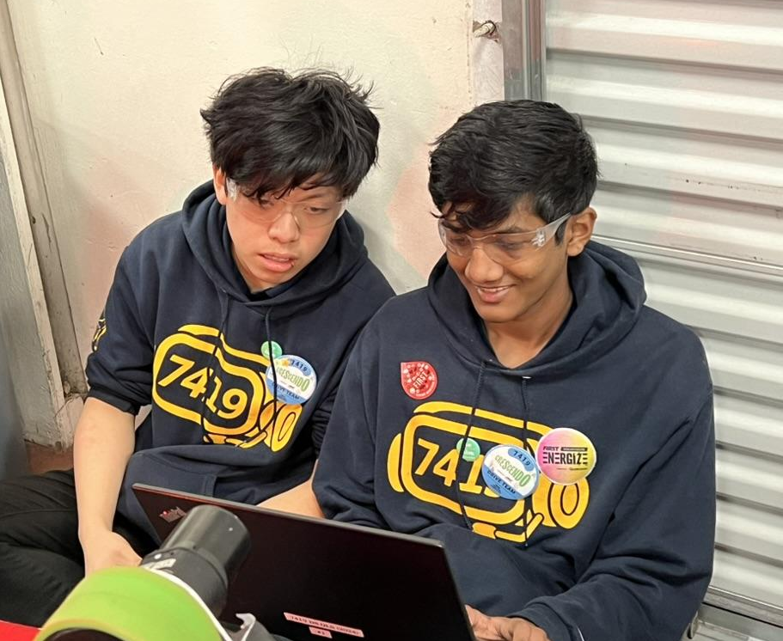
Introduction
Team 7419’s student-led programming department
Notes:
kaival william stephen

Slide 4
Who We Are
Our student-led nature provides members with ownership over their contributions during the build season
Due to the lack of programming mentorship, the student leadership team needs to find a balance between personal contributions and leaving work for newer members to get involved
In order to accommodate the wide range of prior experience, we’ve also paired each member with a student mentor
Notes:
kaival

Slide 5
Problems we’ve had
Difficult to engage ~40 new members
Unsynchronized between different Robotics Independent Study (RIS) periods
Keeping members accountable in completing assignments
Keeping members engaged, while allowing room for exploration
Student leads will take charge during the build season, leaving new members left behind
Notes:
william

Slide 6
Our system
Offseason
Weekly Workshops
Activities
Build season
Taskboard
Delegating easier tasks rather than doing them ourselves
Delegating harder tasks to experienced and less experienced members
Notes:
kaival

Slide 7
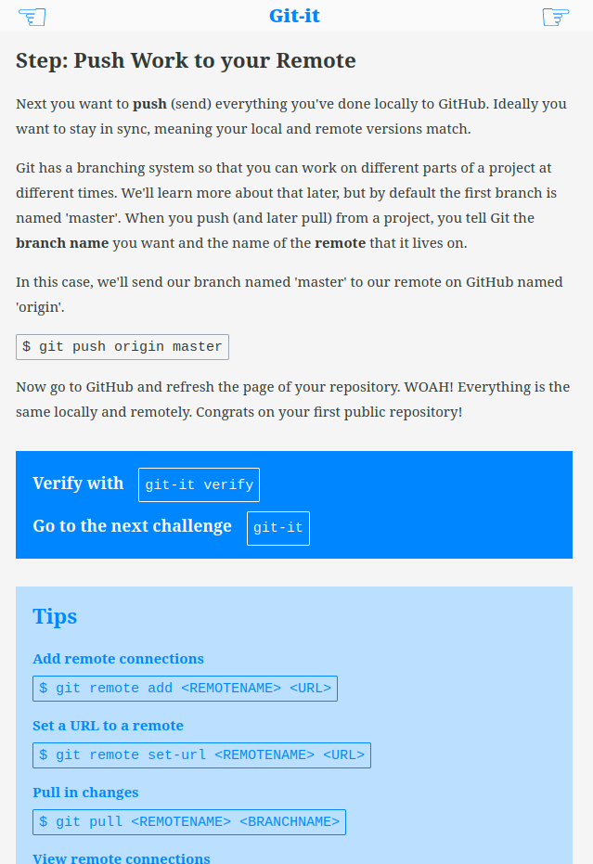
Git Training Using Git-It
Git-it is an interactive app allows students to self-check and verify their actions
Students progress in Git knowledge from basics to more nuanced concepts
We chose CLI over GUI
Beneficial for foundational understanding
Useful skill applicable in future careers
Notes:
kaival

Slide 8
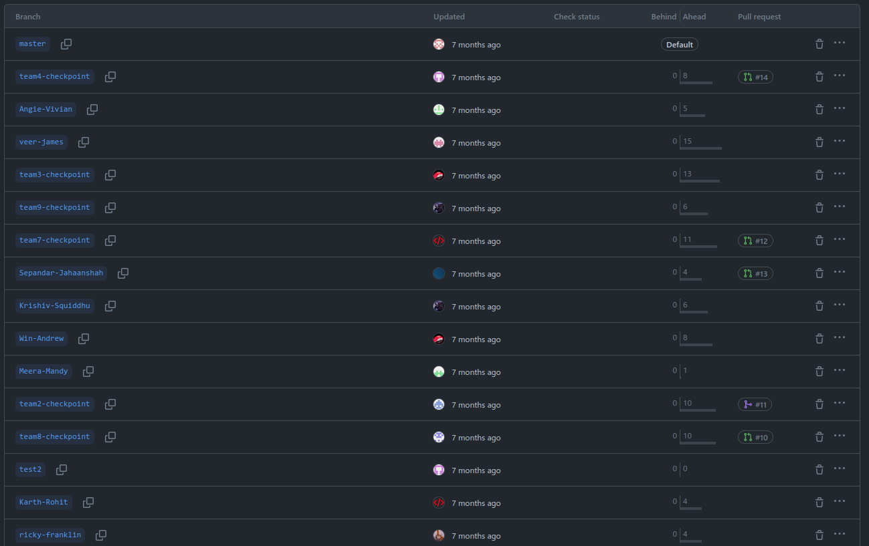
Solve an AP CSA Problem
Students work in pairs to practice using branches, pushing and pulling, and resolving merge conflicts
Opportunity to use version control, interface with others
Git Tag Team Activity
Applying source control
Notes:
William

Slide 9
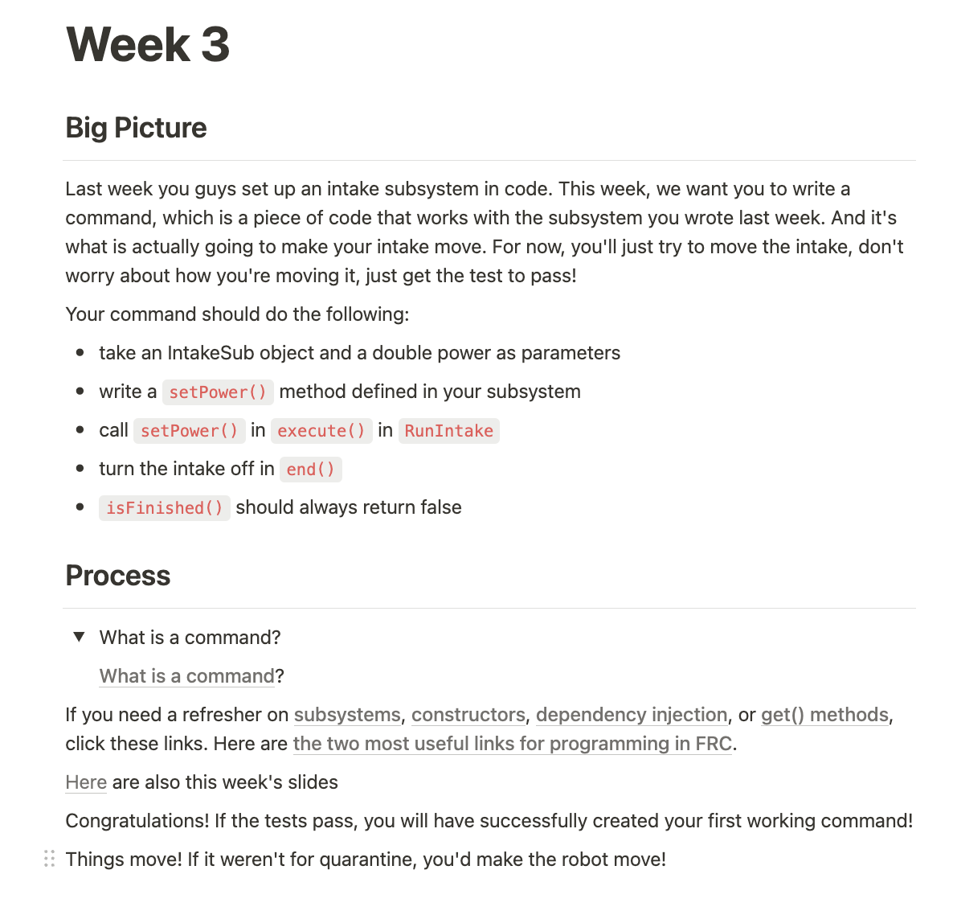
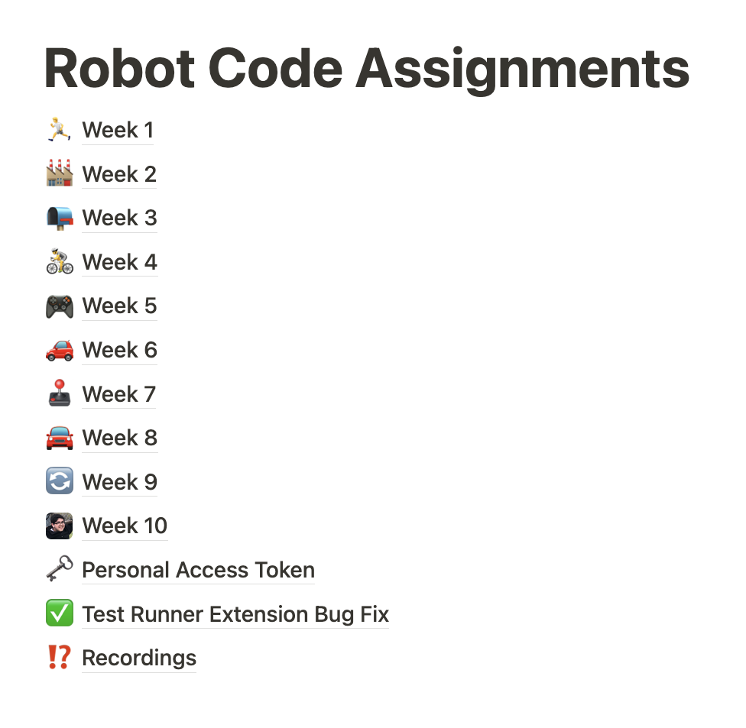
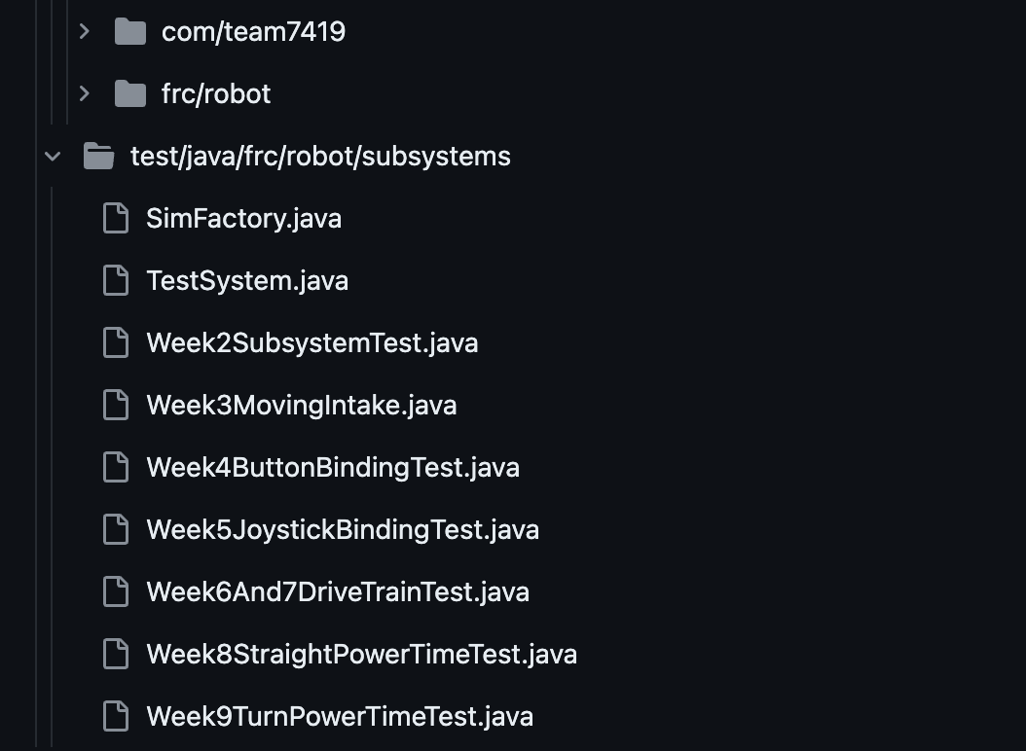
Offseason Training Assignments
10 Weeks of Robot Code Assignments and Unit Tests
Explanations to Robot Code Assignments
Notes:
kaival

Slide 10
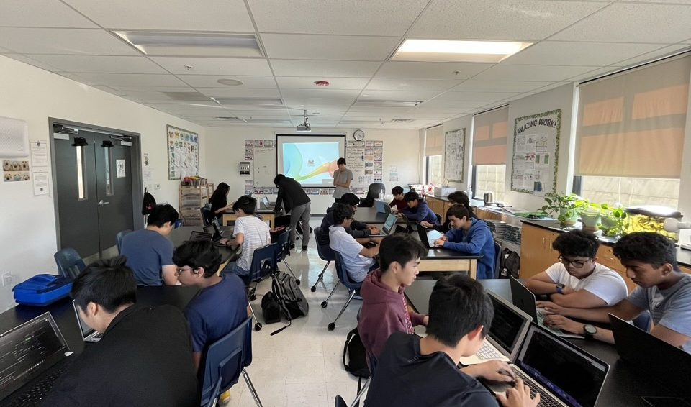
Outline the subsystems in a previous year’s robot
Program TeleOp of an entire robot within an hour
Practice proper Git workflow to be utilized during the build season
Introduce conventions
Command-Based Programming Activity

Slide 11
Work with electrical to setup sensors on a testing board
Groups present their research about a sensor’s mechanisms and applications
Develop their own advanced project
Sensors Assignment
Notes:
william

Slide 12
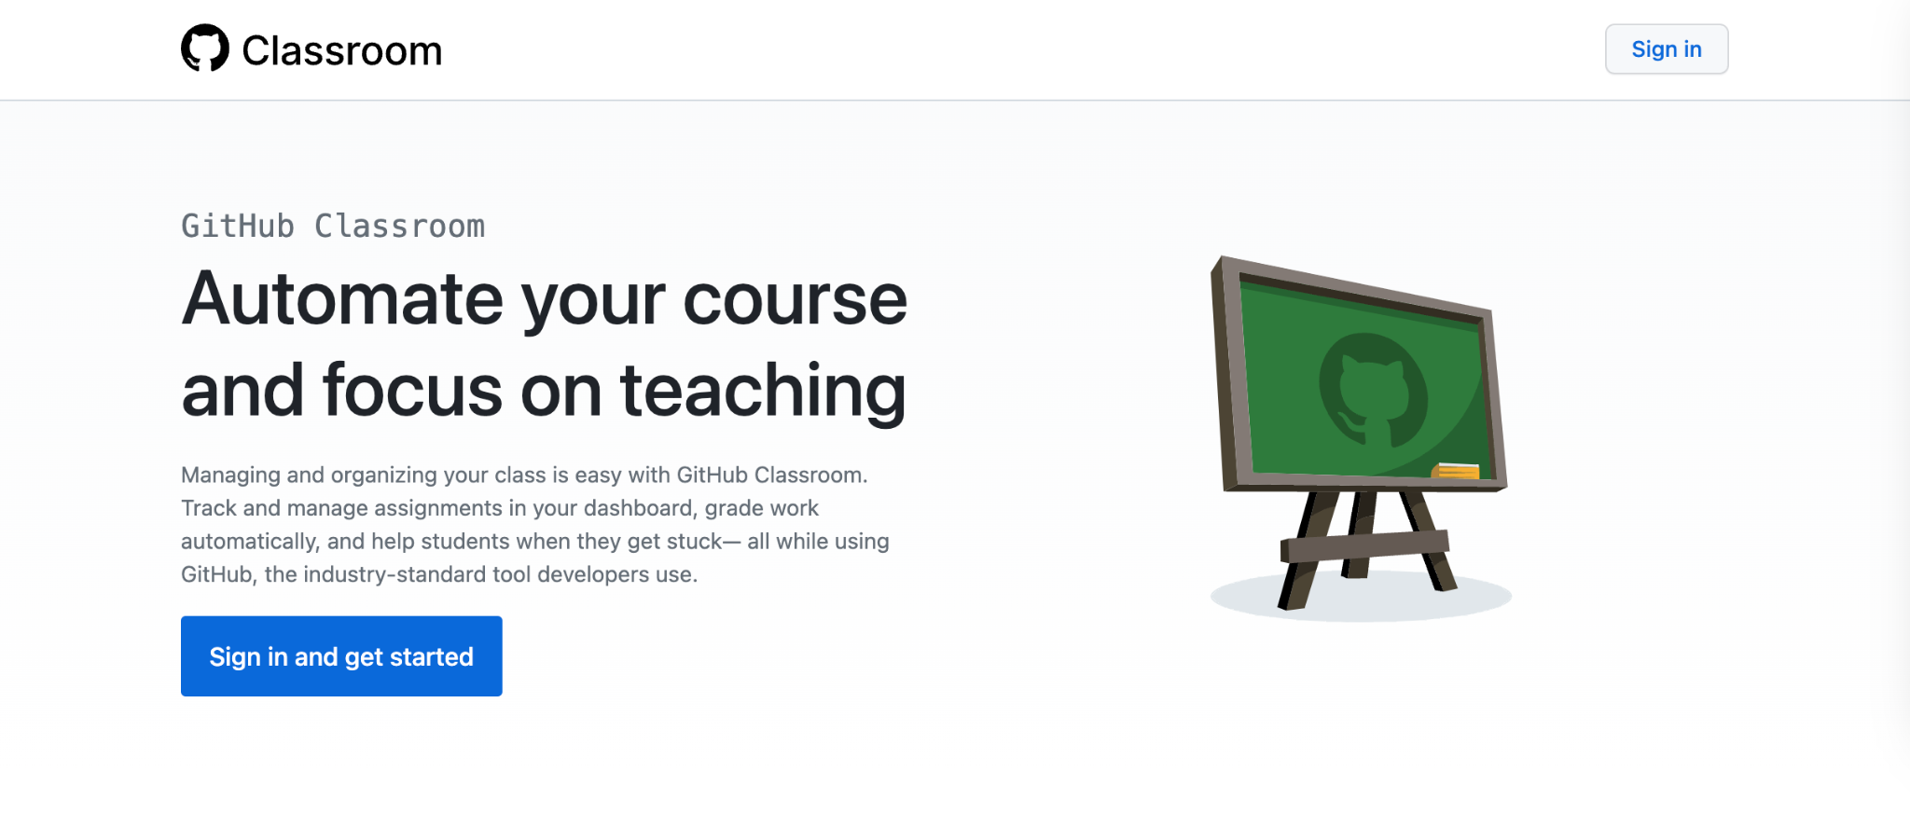
GitHub Classroom
Example Classroom: https://classroom.github.com/classrooms/47046213-champsdemo/roster
Notes:
kaival

Slide 13
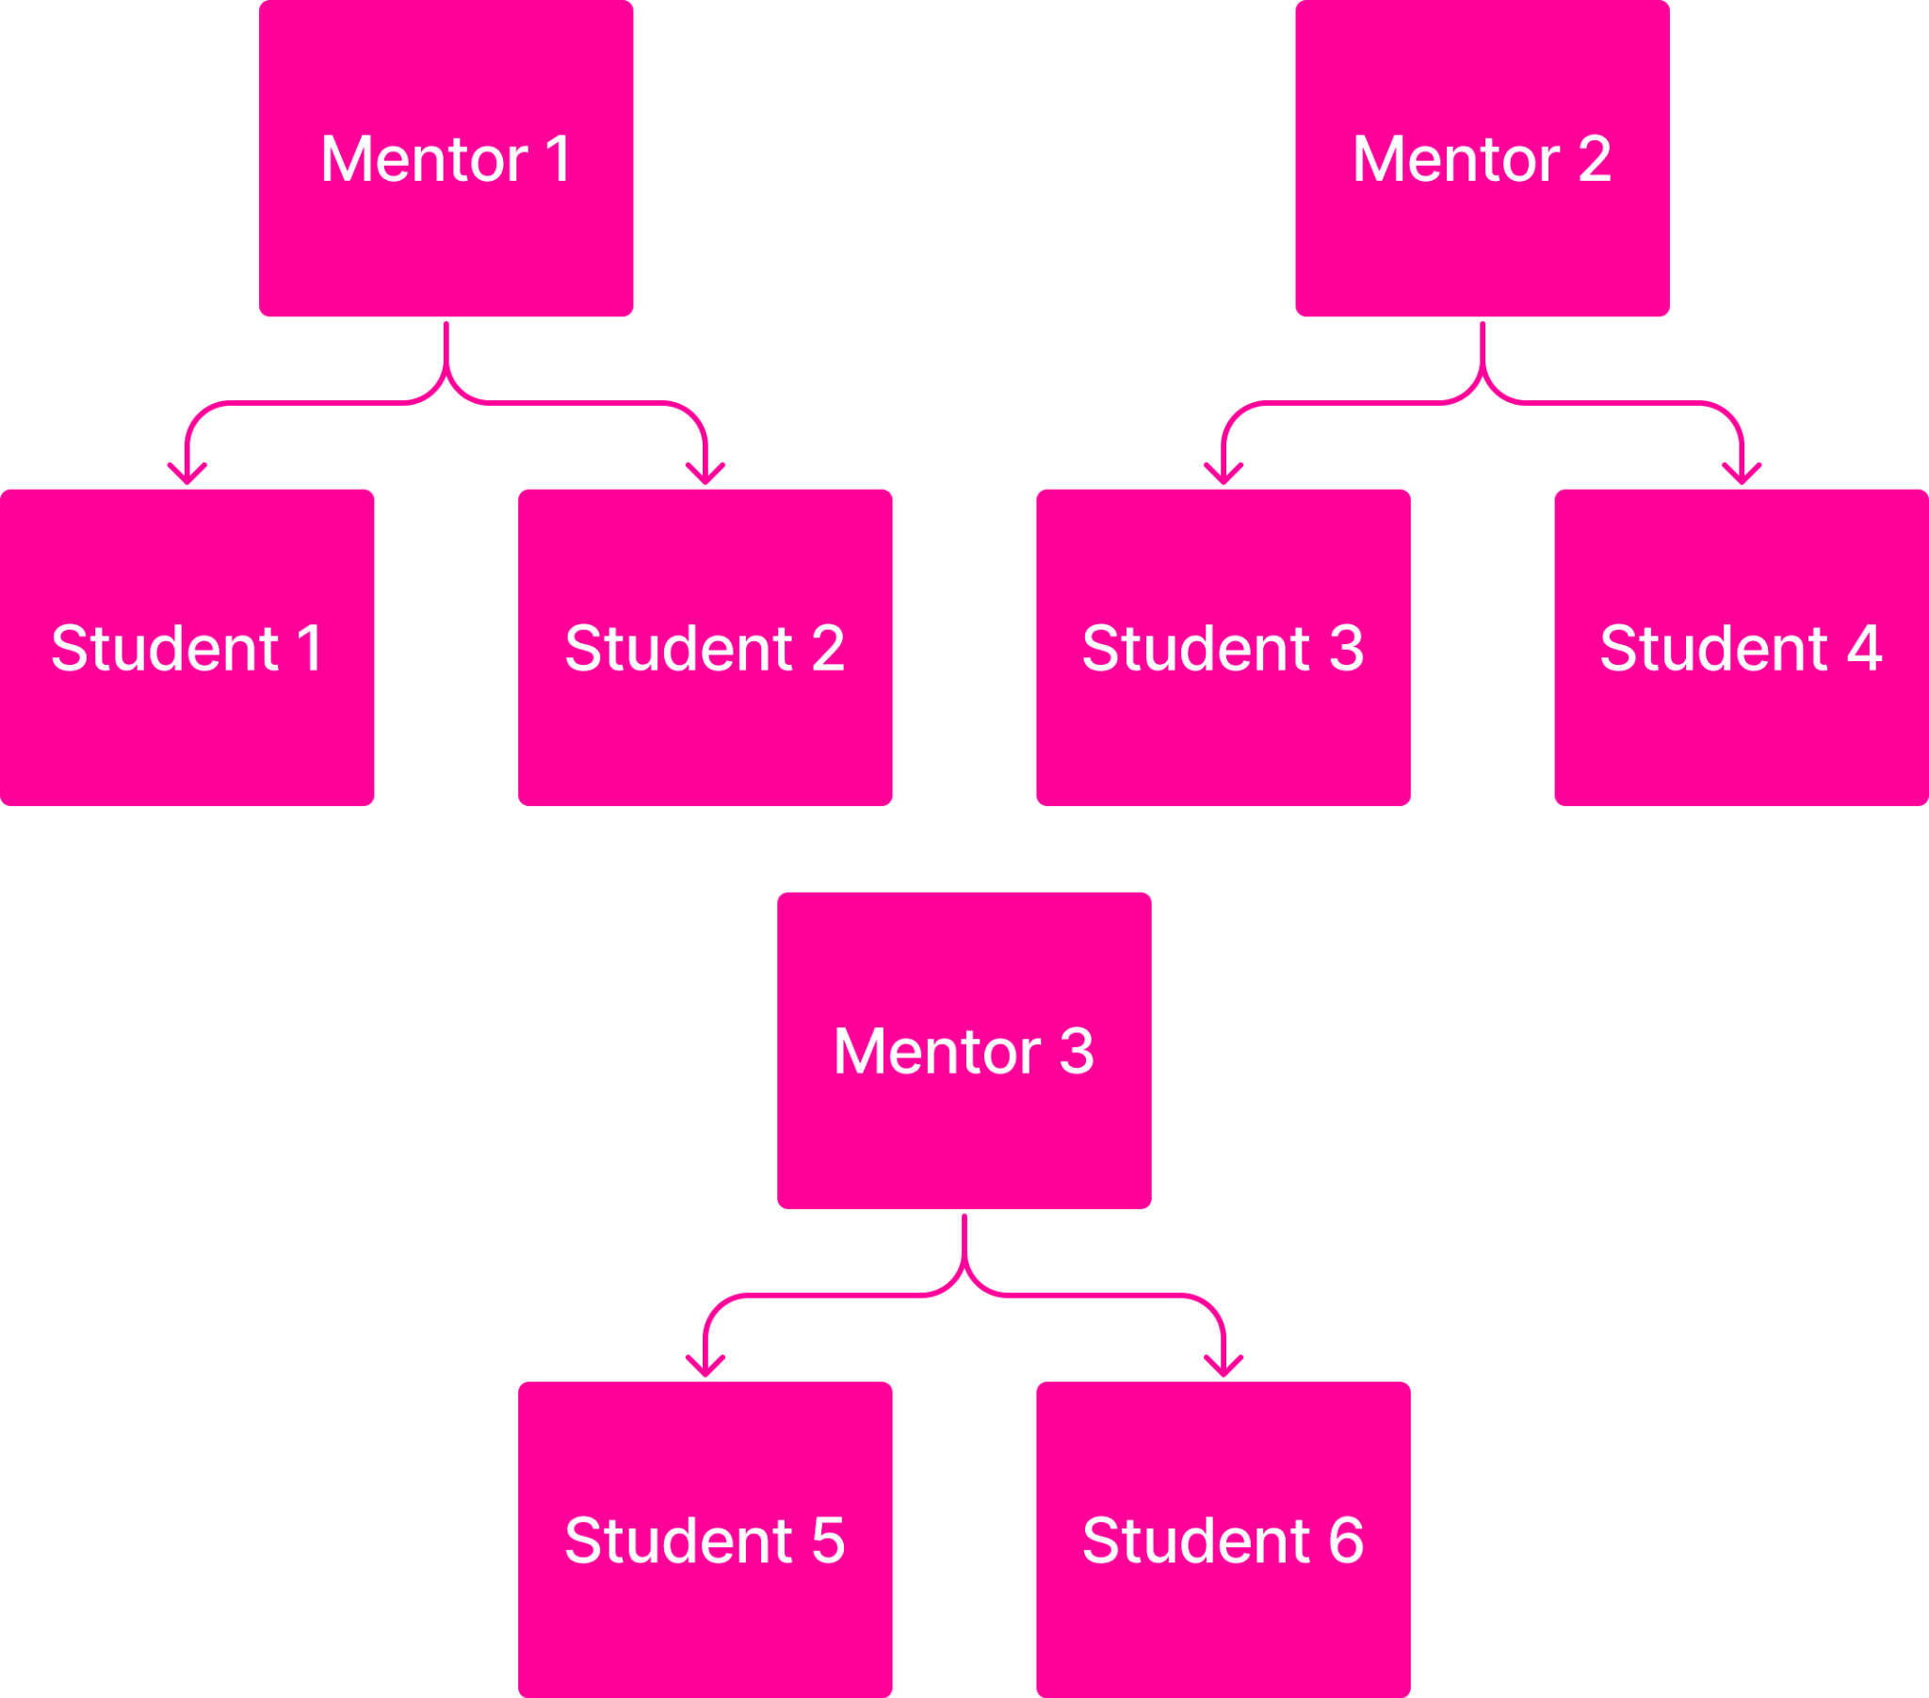
Interactive Team Activities
Build team environment
People will be more comfortable sharing what they don’t know with peers
Hosting sessions for students to ask questions and/or collaborate with other students on tasks
Notes:
kaival

Slide 14
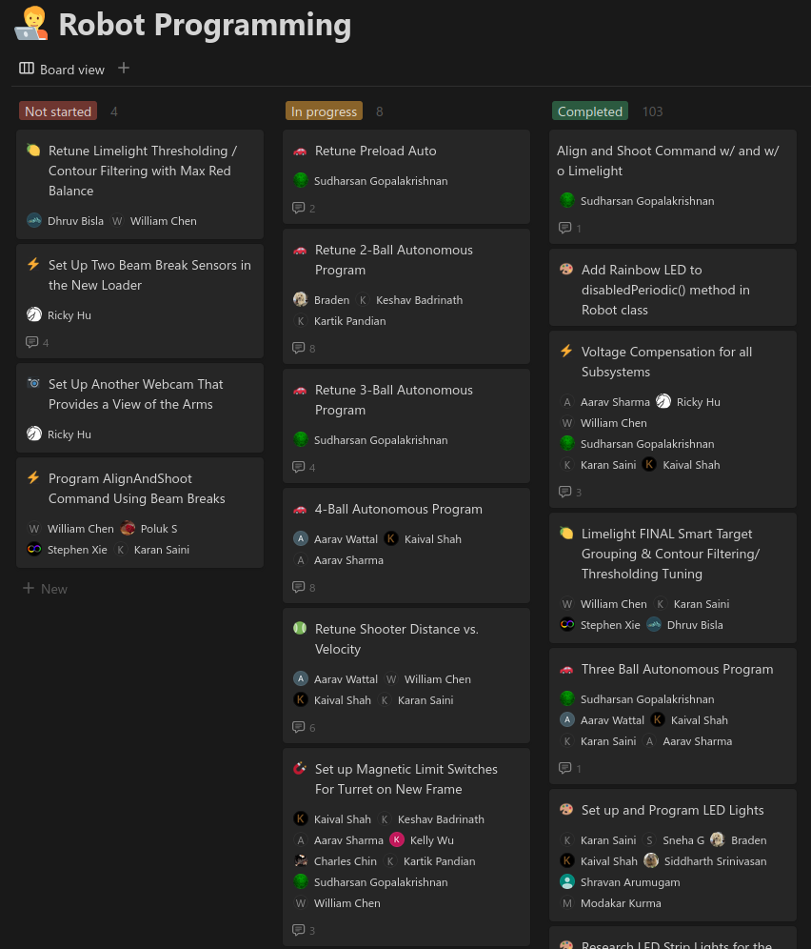
Build Season
Notion Taskboard
Task assignment before every work period
Detailed instructions and resources to work independently
Everything tested is documented for future seasons
Notes:
william

Slide 15
Summary
Offseason Training Assignments
Git-It: https://github.com/jlord/git-it-electron
GitHub Classroom: https://classroom.github.com/
Interactive Team Activities
Collaboration periods
1:2 Student Mentor to Student ratio
Sensors assignment
Build Season Member Ownership
Notes:
kaival

Slide 16
bmartin@quarrylane.org
7419.tech

